Slide 1
COVID-19: Understanding the incubation and contagious periods of the disease
Group E: Ayomide Owoyemi, Vipul Dhariwal, & Lydia Tse

Slide 2
Introduction
Understanding the course of the novel COVID-19 disease is important in guiding public health measures to detect, control and prevent the spread of the disease. A good knowledge of the incubation period and post-recovery infectivity of the disease will help in making effective quarantine and isolation decisions that will be helpful in controlling the spread of the disease.

Slide 3
Aim
The aim of this study is to determine the incubation period and infectivity period of COVID-19.

Slide 4


Datasets Used
Semantic Scholar’s COVID-19 Open Research Dataset (CORD-19) [1]
Contains over 280,000 scholarly articles
COVID-19 Literature Knowledge Graph from Steenwinckel et al. [2]
Contains 5,151,961 N-Triples with 1,362,044 subjects and 9 predicates.

Slide 5
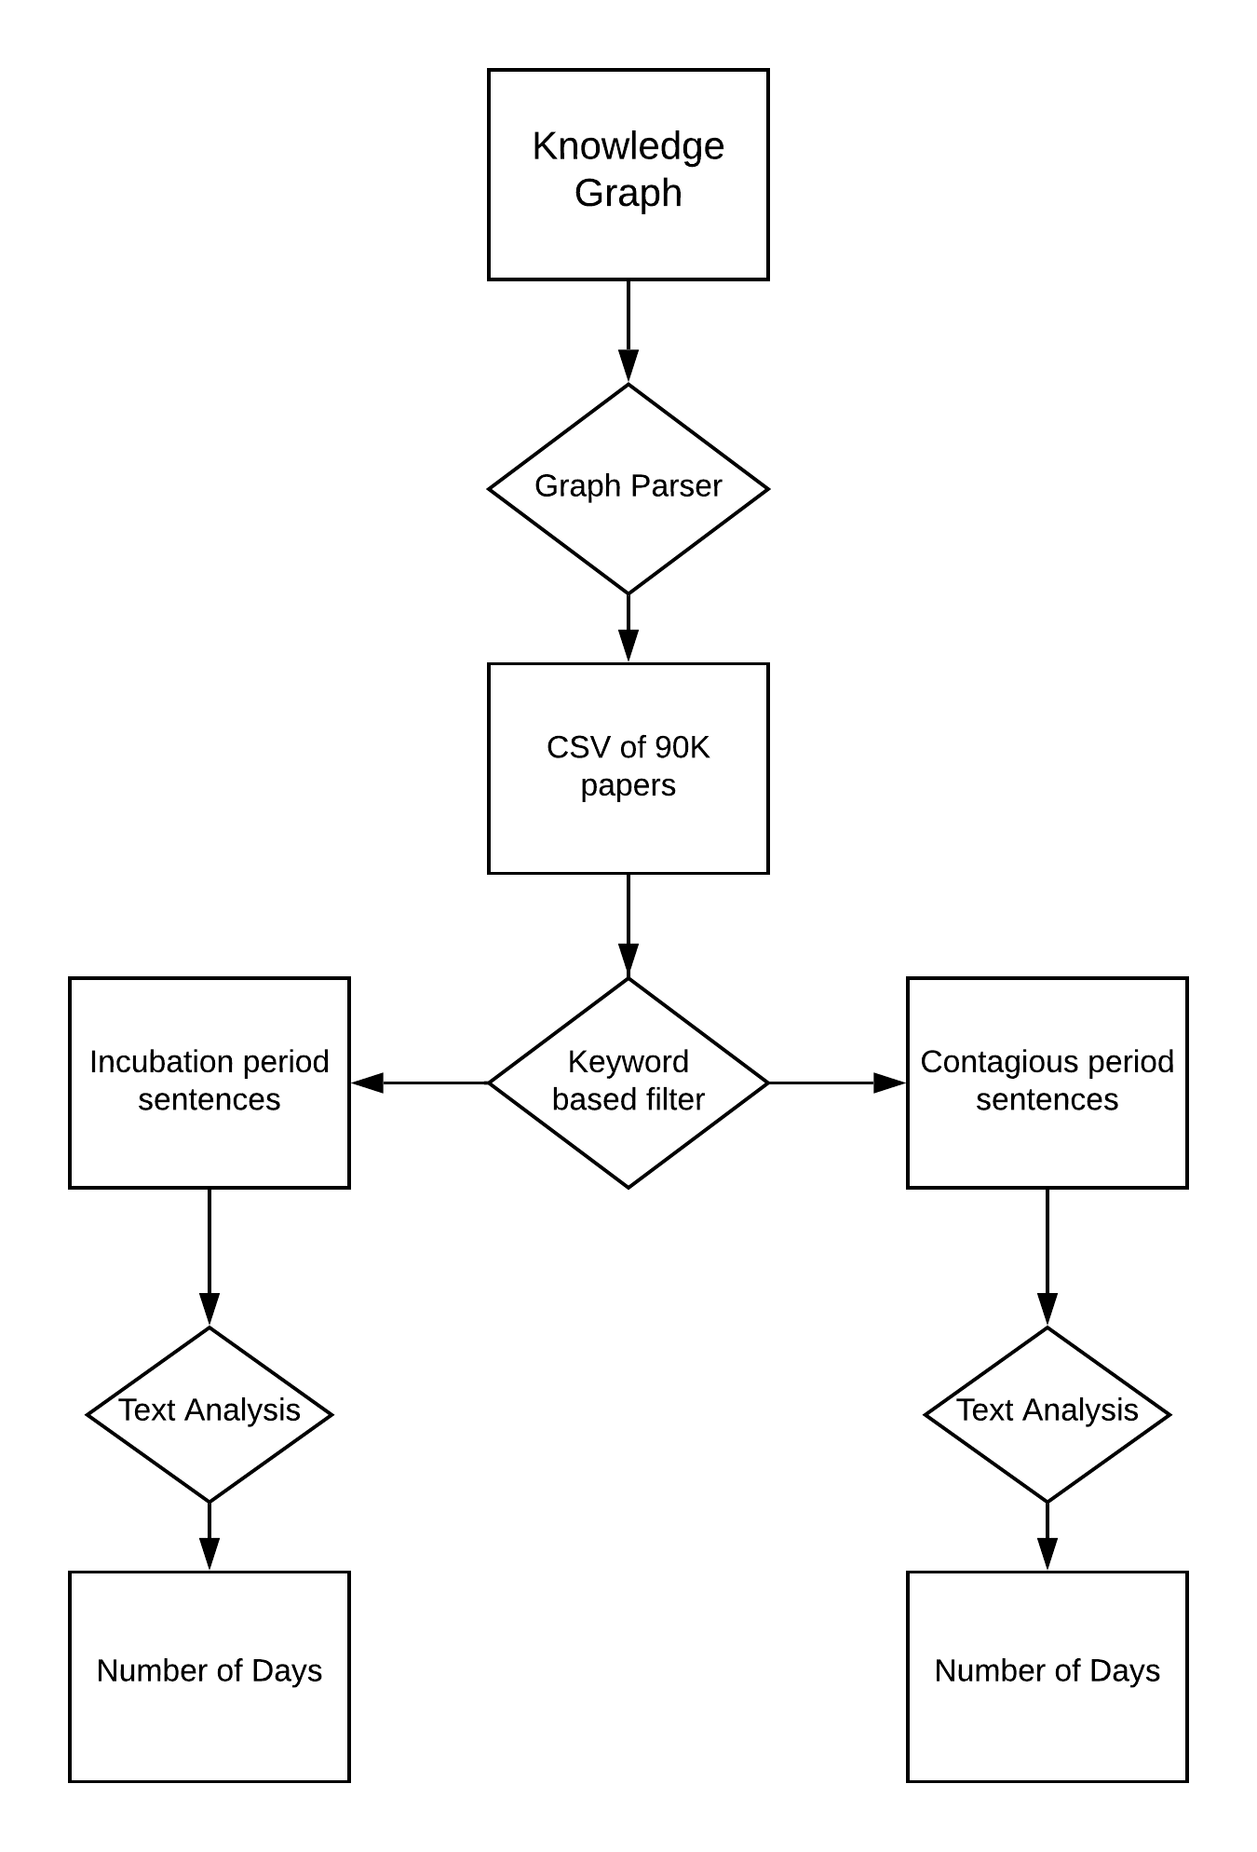
Flow

Slide 6
Methodology: Step by Step Overview
Identify keywords associated with incubation period
Extract the relevant papers from the CORD-19 dataset using regex query
Use the Closed Domain Question Answering (cdQA) library and spaCy’s Named Entity Recognition (NER) model to find the 'answer' to the query 'what is the incubation period'
Filter extremities and unrecognizable characters
Repeat the third step again
Generate the PageRanks
Utilize the PageRanks to add weights to number of days suggested by each paper.
Evaluation

Slide 7






Tools Used
Python & regex knowledge
cdQA Library & the spaCy’s NER model for answering the query
pandas library to read the csv files
rdflib and networkx for running the PageRank algorithm on the literature knowledge graph

Slide 8
Results
Incubation Period
Contagious Period
Number of Unique Papers | 8357
Range | 3.5 to 13.5 Days
Mean | 8.41 Days
Weighted Mean | 8.38 Days
Median | 9 Days
Standard Deviation | 5
Number of Unique Papers | 2700
Range | 3 to 7 Days
Mean | 5.43 Days
Weighted Mean | 5.38 Days
Median | 5 Days
Standard Deviation | 2.12

Slide 9
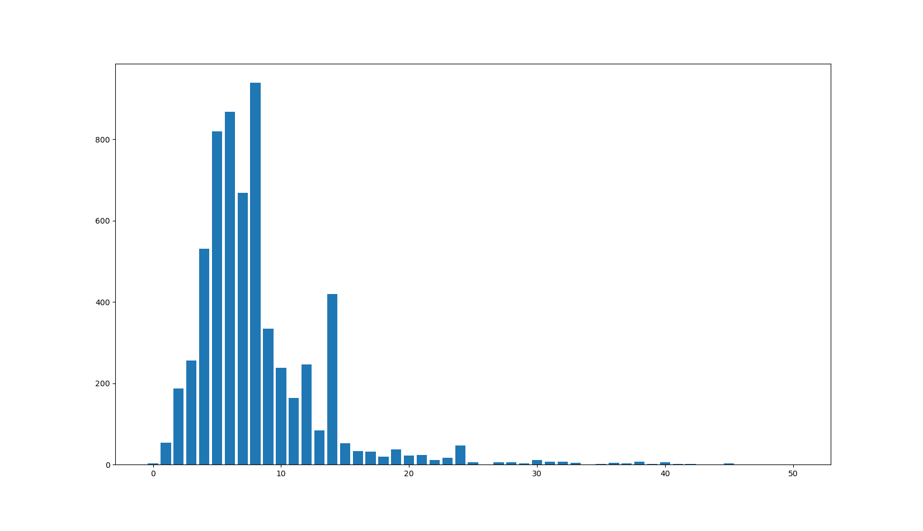
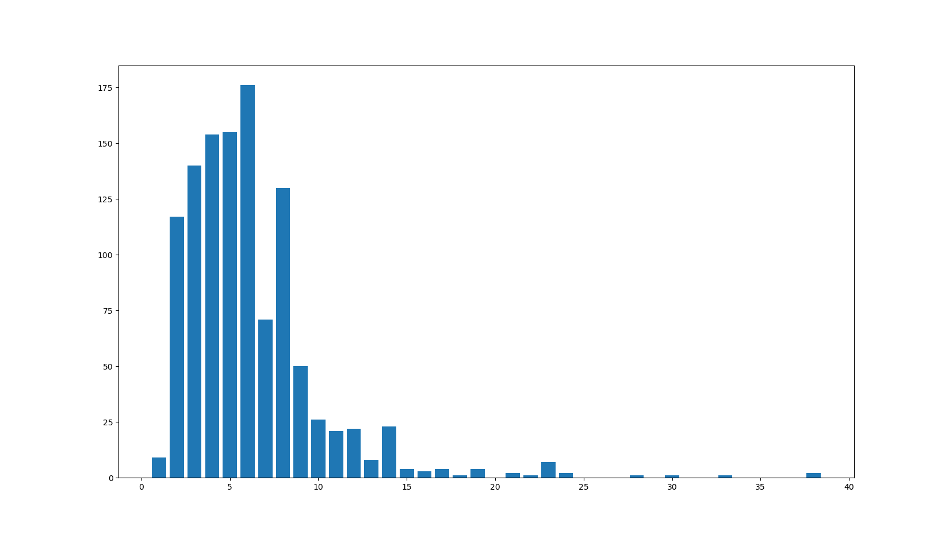
Results
Incubation Period
Contagious Period
Number of Papers
Number of Papers
Suggested Incubation Period (Days)
Suggested Contagious Period (Days)

Slide 10
Accuracy
Randomly studied 100 papers
The average incubation period was 8.5 days ( we got 8.38, not bragging)
The average contagious period was 4.5 days ( we got 5.4)

Slide 11
Scope of Project
Initial Aim => Transitive reduction on a disease-symptom knowledge graph to improve accuracy
Setback => No knowledge graph available in public domain
Hustled back => Solving a query regarding a very important topic
Exact Aim => Getting credible information in queries of COVID-19 from research papers

Slide 12
Gives us a semester and funds and we will...
Since the pipeline is robust,
Increasing number of papers will increase the accuracy
Can answer any statistical answer with a good credibility (no training)
Want to know how much water intake is suggested for teenagers? We can answer
Medical professionals do not have rely on just 3-4 papers to get the numbers

Slide 13
Discussion
The results of our study showed a mean incubation of 8.41 days (SD = 5) with a weighted mean of 8.38, this result differs from those obtained in systematic reviews conducted by Wassie et al, McAloon et al and Quesada et al which showed mean incubation periods of 5.7 days, 5.8 days, and 5.6 days respectively.
We also found a contagious period of 5.43 days (SD= 2.12) with a weighted mean of 5.38, this is different from the outcomes of studies conducted by Singanayagam et al and Morone et al which showed a period of 10 days

Slide 14
Limitations
Out study has certain limitations that may affect the reliability of our results; the included studies were a mix of observational studies and randomized control trials, we used an aggregate of the incubation and contagious periods directly from the collected studies without conducting any meta analyses, we did not consider gender or age differences in our estimates. We also did not consider the severity of the disease in our analysis of the contagious period after illness from COVID-19.

Slide 15
Conclusion
The incubation contagious period of COVID-19 based on this study were 8.38 and 5.38 respectively. These results might not be reliable based on some limitations, but they give a significant insight based on the number of studies involved in arriving at the estimates. There will be a need for a more robust way to analyze this large amount of data to arrive at a more reliable estimate of both periods.

Slide 16
References
[1] CORD-19 | Semantic Scholar. (2020, November 05). Retrieved from https://www.semanticscholar.org/cord19.
[2] Steenwinckel B., Vandewiele G., Rausch I., Heyvaert P., Taelman R., Colpaert P., Simoens P., Dimou A., De Turck F. and Ongenae F. Facilitating COVID-19 Meta-analysis Through a Literature Knowledge Graph. In Proc. of 19th International Semantic Web Conference (ISWC), 2-6 November 2020 (accepted).
[3] Ozyurt, I. B.; Bandrowski, A.; andGrethe, J. S.2020. Bio-Answer Finder: a system to find answers to questions from biomedical texts. Database 2020.
[4] Savova, G. K.; Masanz, J. J.; Ogren, P. V.; Zheng, J.;Sohn, S.; Kipper-Schuler, K. C.; and Chute, C. G. 2010. Mayo Clinical Text Analysis and Knowledge Extraction System (cTAKES): architecture,component evaluation and applications. J. Am. Med. Inform. Assoc. 17(5):507–513.
[5] Xing, W., and Ghorbani, A. 2004. Weighted PageRank Algorithm. In Proceedings. Second Annual Conference on Communication Networks and Services Research, 2004., 305–314
Note - Important Papers that helped us most are highlighted

Slide 17
Thank you Professor Cruz and David for all your ever-ready help and knowledgeable guidance
Thank you classmates. It was great fun with you all.

